Slide 1

Skill lab
Go,Change the World

Slide 2
A static web page is a web page that is delivered to the user's browser exactly as stored, without any server-side processing or dynamic content generation.
🔹 Key Features of a Static Web Page:
Fixed content: The content doesn’t change unless the source code is manually edited.
Built using: HTML, CSS (sometimes JavaScript for visual effects).
Fast loading: Since no processing is required on the server.
No databases: All data is hard-coded into the page.
Best for: Personal websites, documentation, portfolios, landing pages, etc.
Go,Change the World

Slide 3
Cloud computing
Go,Change the World
Technologies Used in Static Web Pages
HTML (HyperText Markup Language): for structure/content
CSS (Cascading Style Sheets): for styling and layout
JavaScript (optional): for adding basic interactivity (e.g., image sliders)

Slide 4
Characteristics of Static Web Pages
Content is hard-coded into the HTML files.
Each page is a separate HTML file.
No interaction with databases or backend programming languages.
Quick and easy to build, especially for beginners.
Fast to load since there is no server-side processing.
Requires manual updates to change content.
Go,Change the World

Slide 5
Advantages of Static Web Pages
✅ Speed: Very fast load time.
✅ Security: Fewer vulnerabilities since there's no server-side code.
✅ Cost-effective: No need for server-side technologies or databases.
✅ Easy to host: Can be hosted on any web server or even GitHub Pages.
Go,Change the World
Disadvantages of Static Web Pages
❌ No personalization or interactivity: Content is the same for all users.
❌ Manual updates needed: Not ideal for frequently changing content.
❌ Not scalable for large websites with hundreds of pages.
❌ No user input handling: Cannot process forms or store user data directly.

Slide 6
🔷 Characteristics of Dynamic Web Pages
Content is generated dynamically based on user input or other factors.
Often connected to a database for reading/writing data.
Can display different content for each user.
Requires server-side processing.
Often used in web applications, blogs, forums, and e-commerce websites.
Examples of Dynamic Web Pages
Social media websites (e.g., Facebook, Twitter)
Online shopping sites (e.g., Amazon, Flipkart)
Email services (e.g., Gmail)
News websites with frequently updated content
User dashboards and login pages
Go,Change the World

Slide 7
Go,Change the World
🔷 Advantages of Dynamic Web Pages
✅ Personalized content for each user (e.g., "Hello, John").
✅ Content management systems (CMS) allow non-coders to update pages (e.g., WordPress).
✅ Database interaction enables features like search, login, comments.
✅ Scalability for large websites with thousands of pages.
🔷 Disadvantages of Dynamic Web Pages
❌ Slower loading times (server-side processing involved).
❌ More complex to develop and maintain.
❌ Higher hosting cost due to backend/server requirements.
❌ Security risks (e.g., SQL injection, if not properly managed).

Slide 8
An S3 bucket is a storage container provided by Amazon S3 (Simple Storage Service) — a cloud storage service by Amazon Web Services (AWS). Buckets are used to store and organize files (objects) in the cloud, similar to how folders are used on your computer.
Key Features of S3 Buckets:
✅ Stores objects: Files such as images, videos, documents, backups, etc.
✅ Highly scalable: Can store unlimited data.
✅ Secure: Supports encryption, access control, and public/private visibility.
✅ Durable and reliable: 99.999999999% durability.
✅ Accessible via the internet (if configured) using URLs.
Go,Change the World

Slide 9
Bucket (container)
│
├── Object 1 (e.g., file1.jpg)
├── Object 2 (e.g., resume.pdf)
└── Folder/Subdirectory
└── Nested Object (e.g., /images/photo.png)
Go,Change the World

Slide 10
How to Use S3 Buckets:
Create a Bucket in AWS Console.
Upload Files (Objects) to the bucket.
Set permissions (private, public, role-based).
Access files via:
AWS SDKs or CLI
HTTP/HTTPS URL (if public)
Use buckets for:
Website hosting
Backup and archiving
Data sharing and distribution
Storing logs and app data
Go,Change the World

Slide 11
Example Use Cases:
Host a static website using S3.
Store user-uploaded images from a web app.
Keep backups of databases or documents.
Serve downloadable content like PDFs or software.
Go,Change the World

Slide 12
Bucket (container)
│
├── Object 1 (e.g., file1.jpg)
├── Object 2 (e.g., resume.pdf)
└── Folder/Subdirectory
└── Nested Object (e.g., /images/photo.png)
Go,Change the World

Slide 13
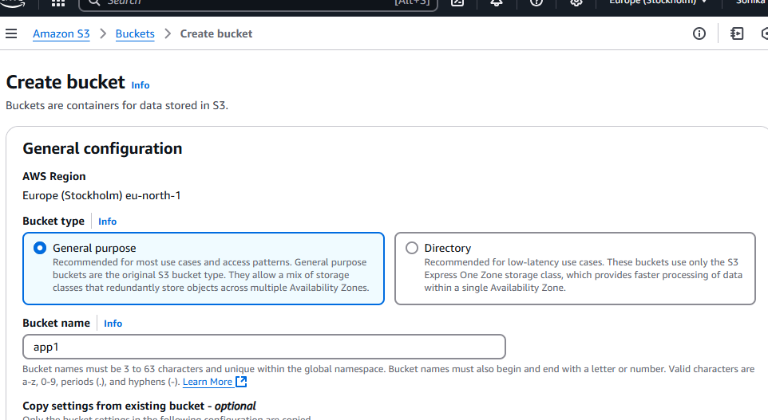
Go,Change the World

Slide 14
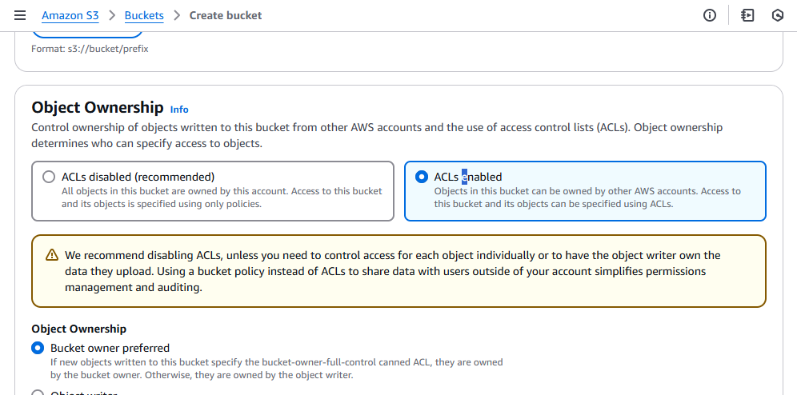
Skill lab
Go,Change the World

Slide 15
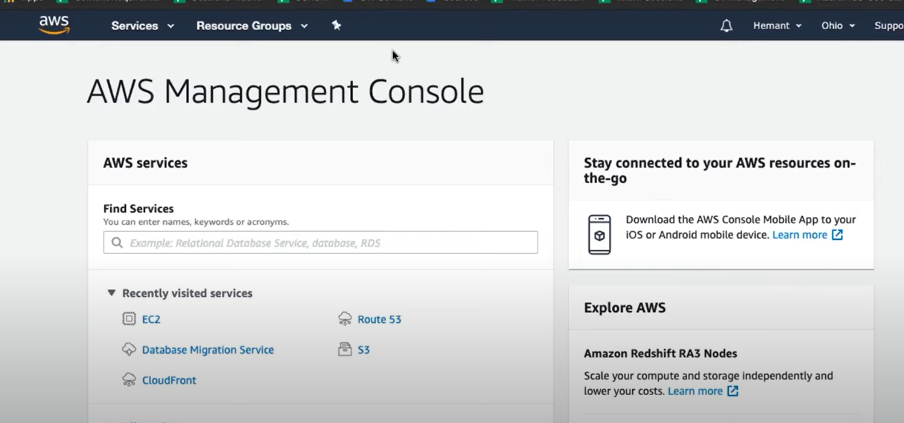

Slide 16
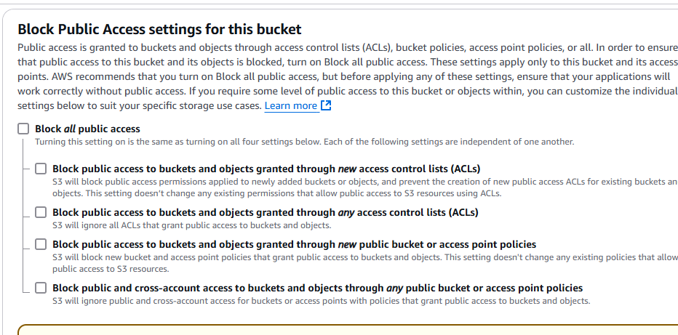
IN SERCH BAR TYPE FOR RDS
THEN CLICK ON CREATE DATABASE

Slide 17
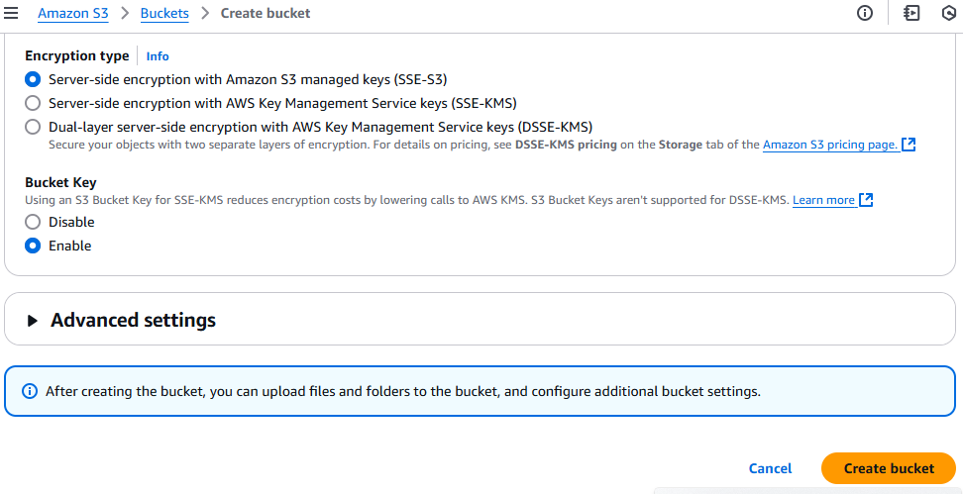

Slide 18
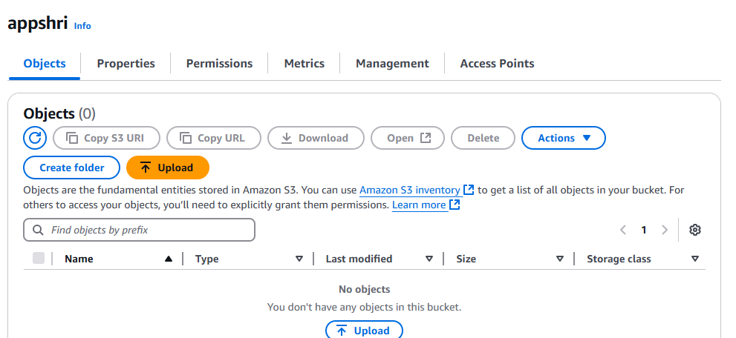

Slide 19
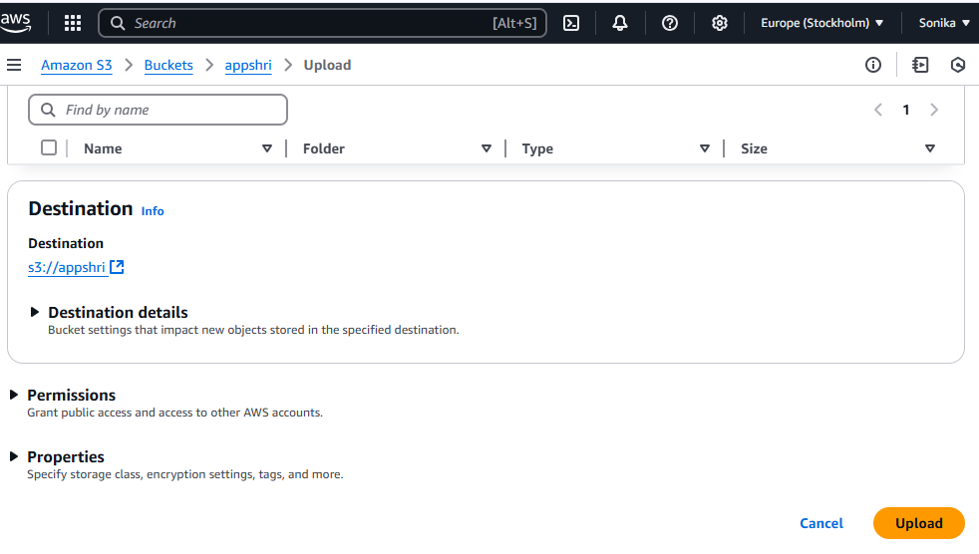
THEN GO TO SETTINGS GIVE ALL YOU DETAILS
REMOVE THE CHECK BOX OF ENABLING AUTO SCALING
THEN GO DOWN AND GIVE PERMISSION FOR PUBLIC ACCESSIBILITY
THEN FINALLY CREATE DATABASE

Slide 20
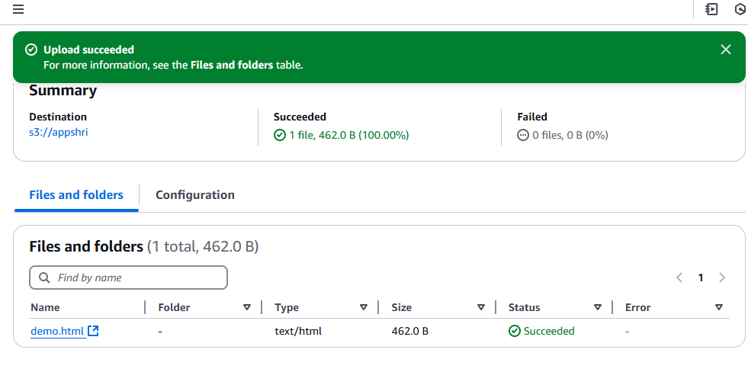

Slide 21
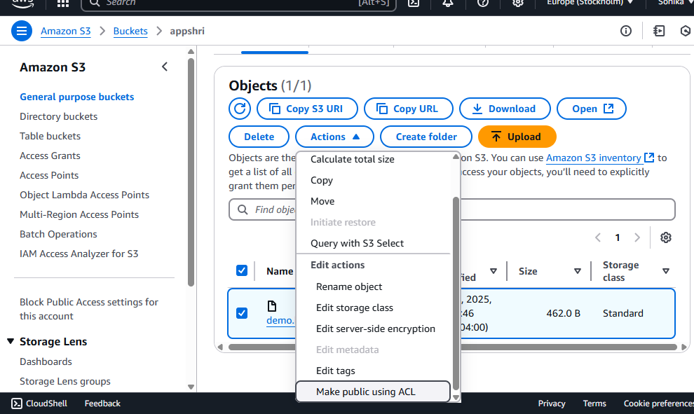
Then come to services search for s3

Slide 22
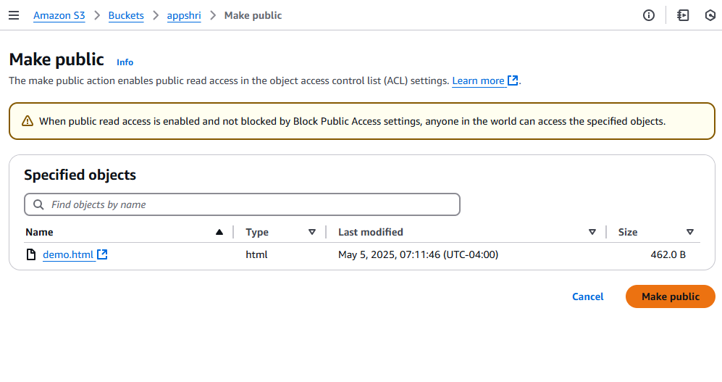

Slide 23
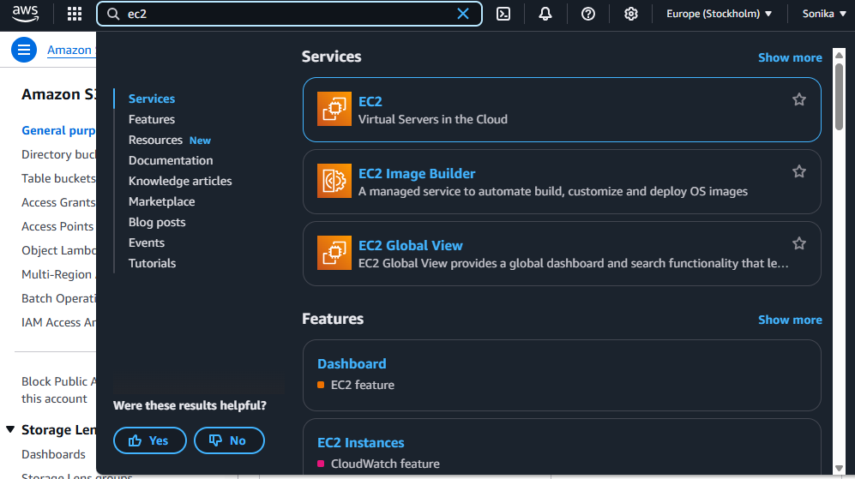
Then you have an option to create bucket click on create bucket

Slide 24
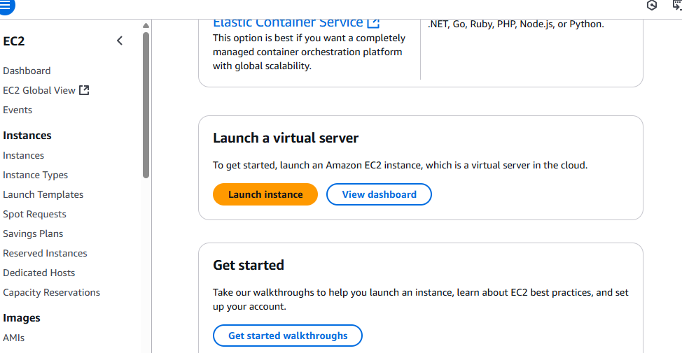
Give the name of the bucket and click on create bucket

Slide 25
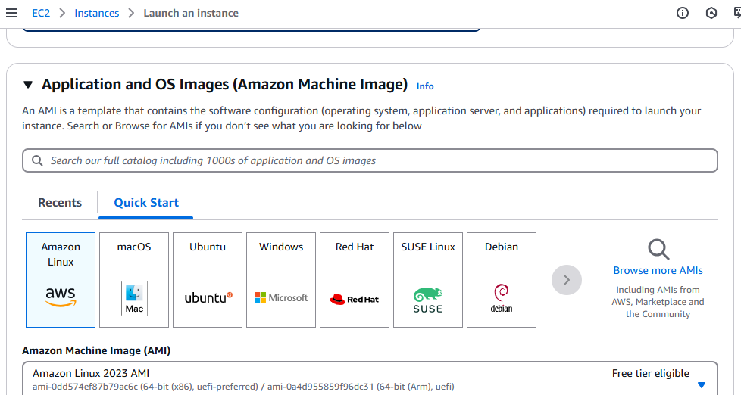
Once it is done it looks something like this

Slide 26
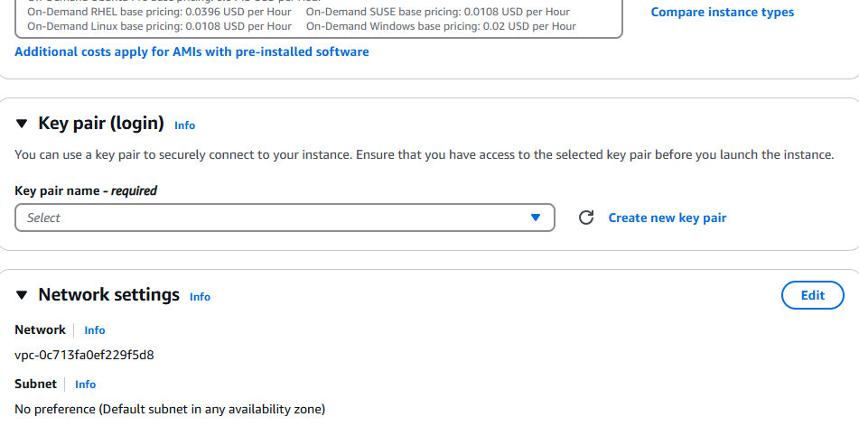

Slide 27
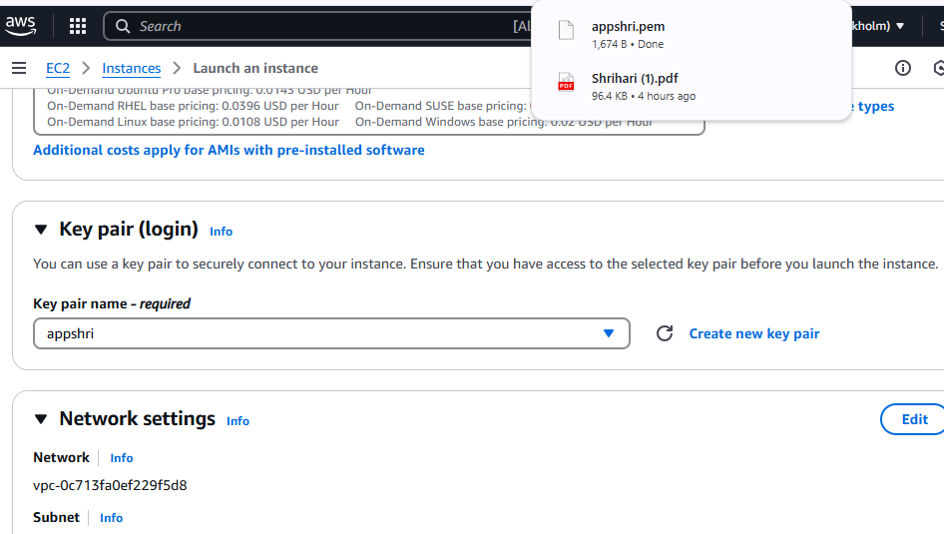

Slide 28
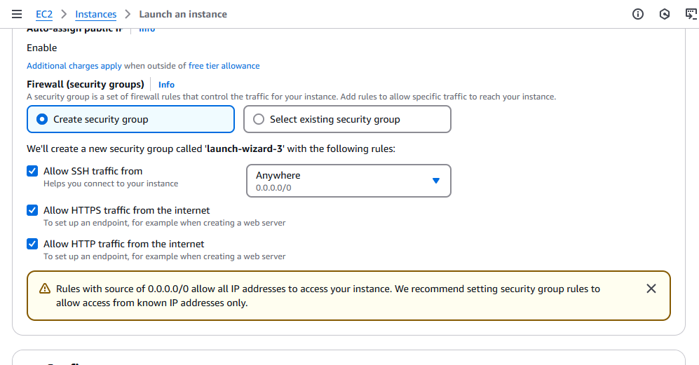

Slide 29
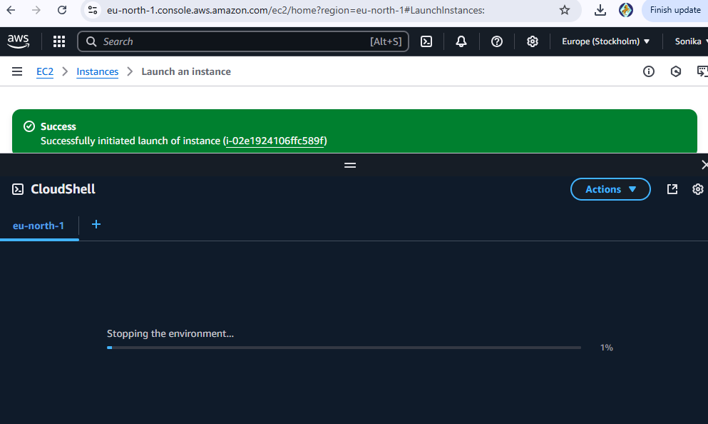

Slide 30
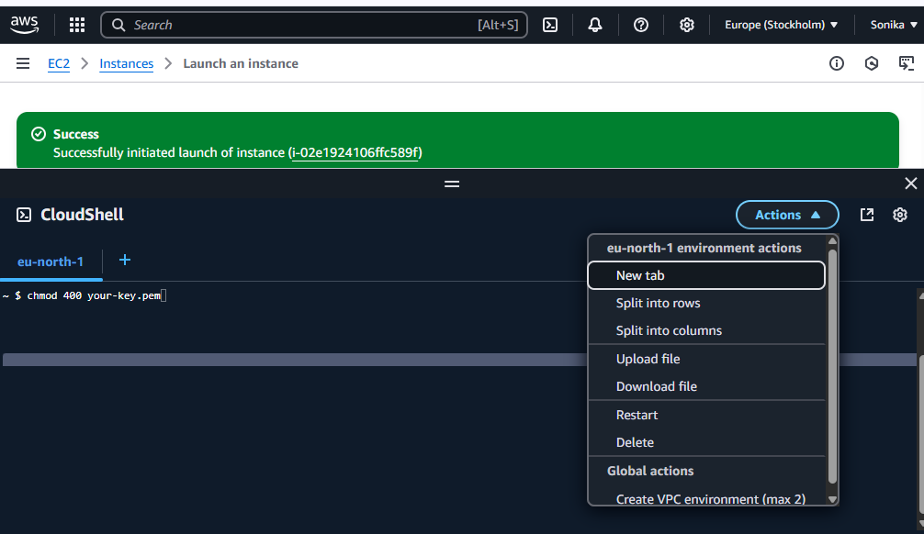

Slide 31
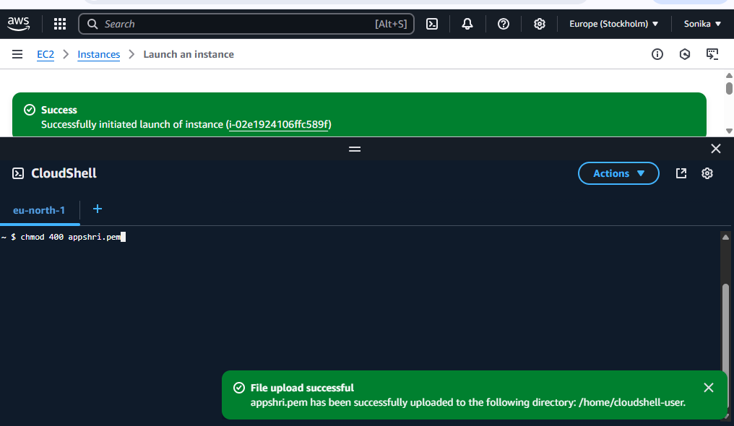

Slide 32
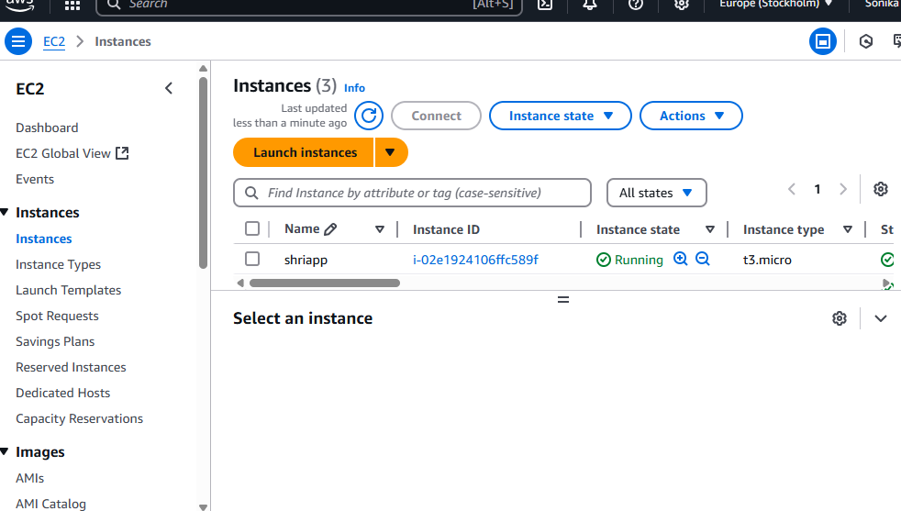

Slide 33
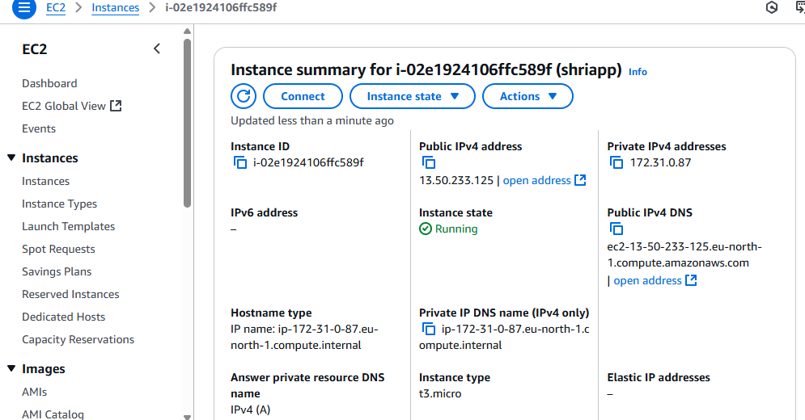

Slide 34
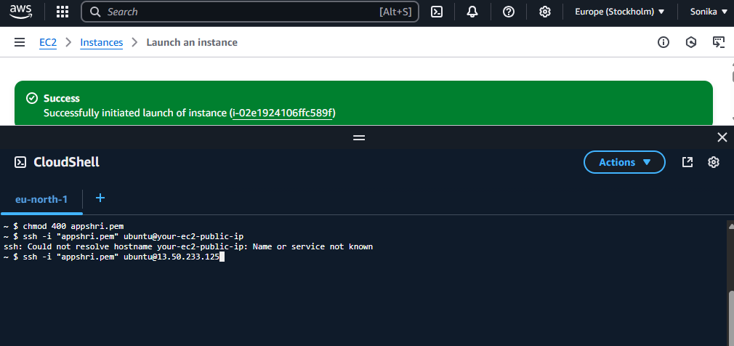

Slide 35
